Slide 1
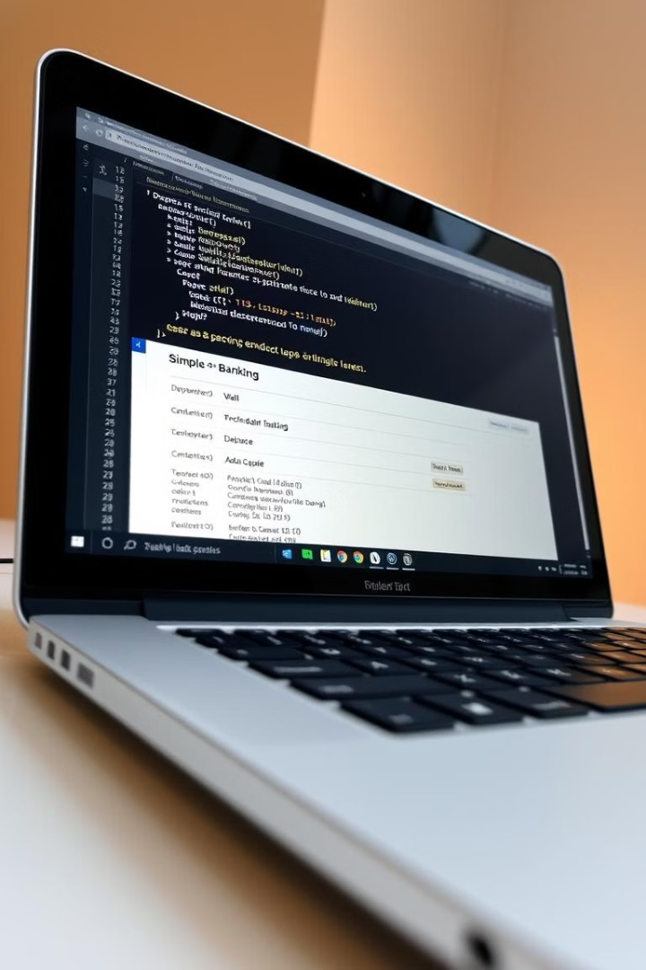
Banking System
This presentation explores the basics of C++ by building a practical banking system. You'll learn about fundamental concepts like variables, data types, input/output, conditional statements, and loops.

Slide 2
Setting Up Your Program: Header Files and Namespaces
Header Files
Namespaces
The #include directive is used to include header files, which contain pre-written C++ code. In our banking system, we use iostream for input and output operations.
The using namespace std; line brings the standard namespace into scope, allowing us to use elements like cout and cin without having to write std:: before them.

Slide 3

Variables and Data Types: Storing Your Data
1
Variables
2
Data Types
3
Initialization
Variables are used to store data. They are declared with a data type and a name, for example: float amount;
The float data type represents decimal numbers. Other common data types include int for integers and string for text.
Variables can be initialized with a value at declaration, for instance: float total = 0;

Slide 4
The Main Function: Your Program's Entry Point
int main()
Return Value
The int main() function is the starting point of every C++ program. It's where program execution begins.
The return 0; statement at the end of main() indicates successful program execution.

Slide 5
Input and Output: Interacting with the User
cout
cin
The cout object is used to display output on the console, for example: cout << "Welcome to the Banking System" << endl;
The cin object is used to read input from the user. We use it to obtain the user's choice and the deposit or withdrawal amounts: cin >> choice;

Slide 6




Decision Making: The Switch Statement
1
switch
case
2
Each case label represents a specific choice, and the code within the case block will execute if the choice matches.
break
3
The break statement prevents the program from executing the code in the next case block.
default
4
The default block is executed if none of the case labels match the user's choice.

Slide 7
Loops: Repeating Actions
do-while Loop
Loop Condition
The do-while loop is used to repeat a block of code at least once, then continue to repeat as long as the condition is true.
The condition in the while statement determines how many times the loop runs. In our banking system, the loop continues until the user chooses to exit (choice != 9).

Slide 8




Key Takeaways and Next Steps
Variables
Control Flow
Practice
Variables are essential for storing data and manipulating it within your C++ program.
Conditional statements like switch and loops like do-while are used to control the flow of your program's execution.
Practice writing your own C++ programs, starting with simple examples like the banking system, and gradually increasing the complexity.

